Slide 1
State & Activity Diagrams

Slide 2
1. State Diagram

Slide 3
State Diagram- Introduction
Use Cases, Class diagrams are used to give an architectural and high-level view of a system
The two diagrams named above are static diagrams, which means that they help in visualizing what the elements of the complete system would be, but do not say anything about the flows any object of the system can have when an event occurs.
While coding, it is necessary to understand the details of the modes an Object of a Class can go through and its transitions at time intervals with the occurrence of any event or action.

Slide 4
State Diagram- Introduction….
State diagrams (also called State Chart diagrams) are used to help the developer better understand any complex/unusual functionalities or business flows of specialized areas of the system.
In short, State diagrams depict the dynamic behavior of the entire system, or a sub-system, or even a single object in a system.

Slide 5
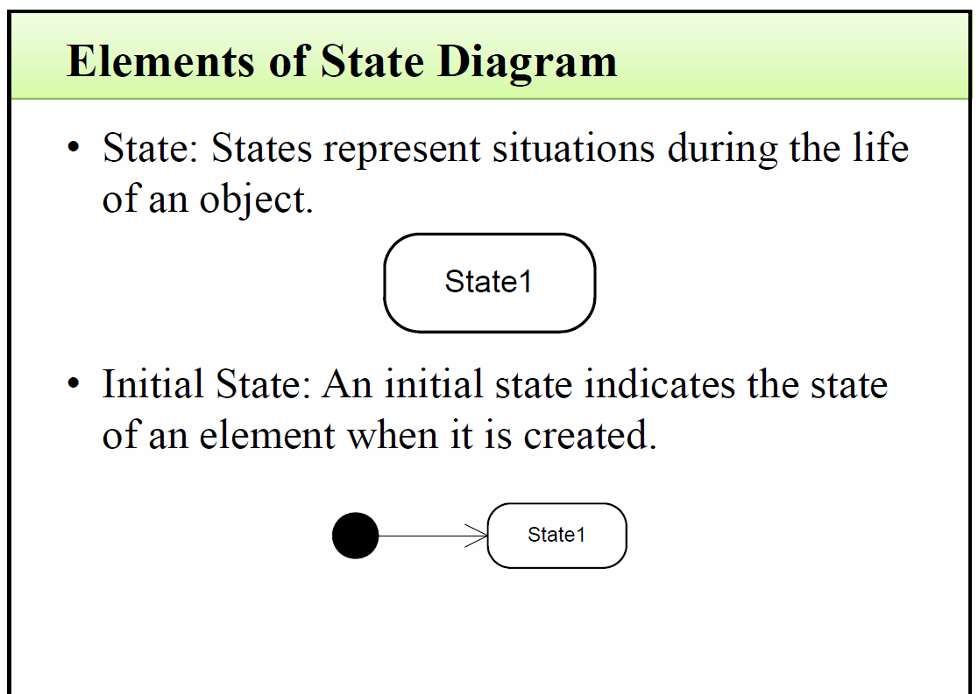

Slide 6
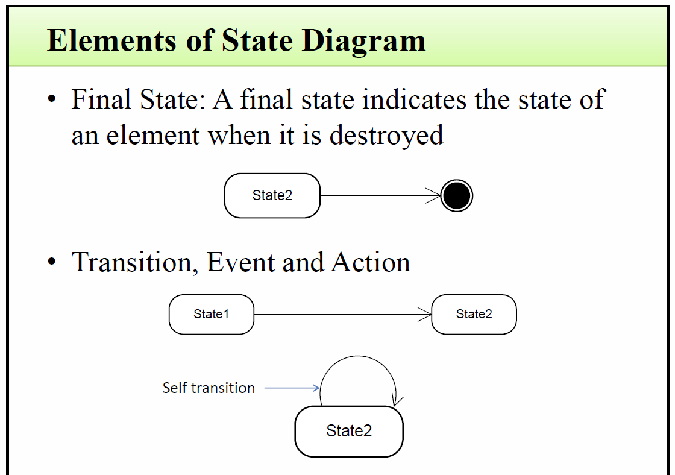

Slide 7
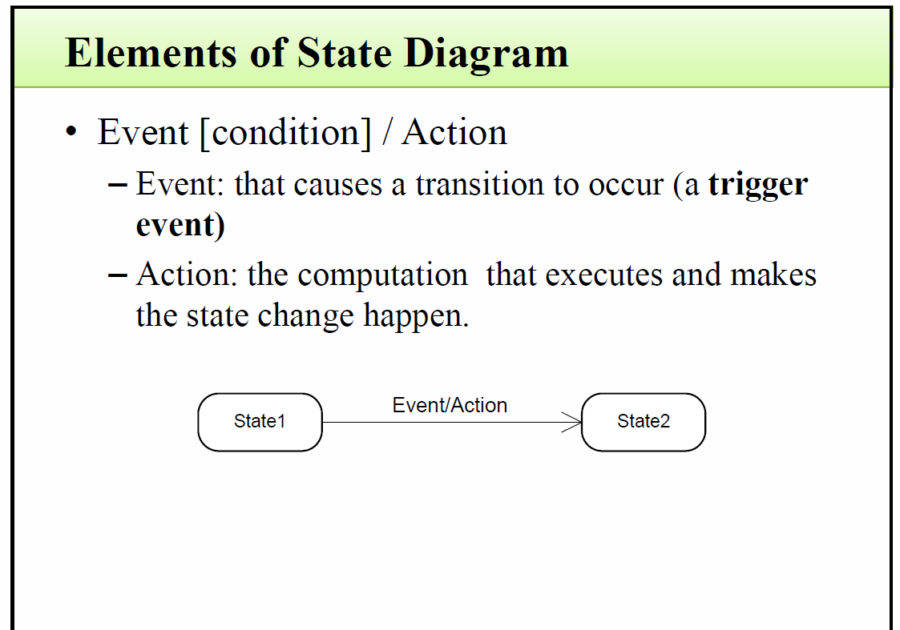

Slide 8
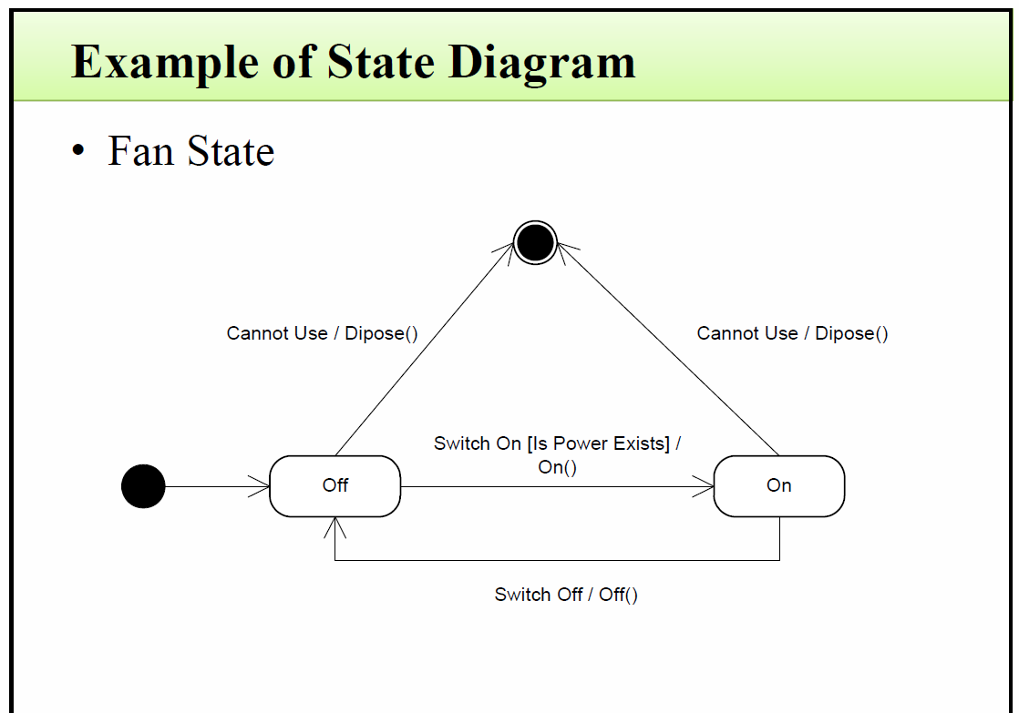

Slide 9
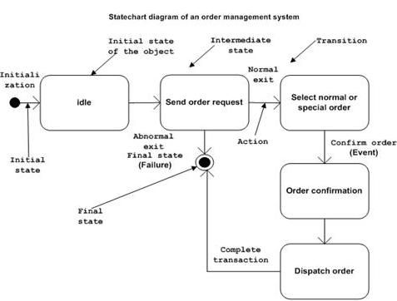
Example 2: Order Management System-state diagram

Slide 10
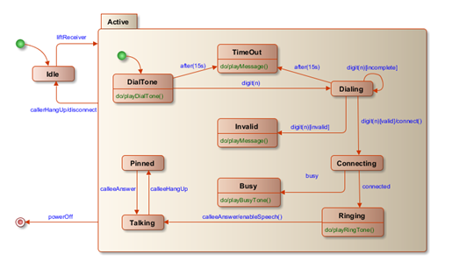
Example 3: Phone State

Slide 11
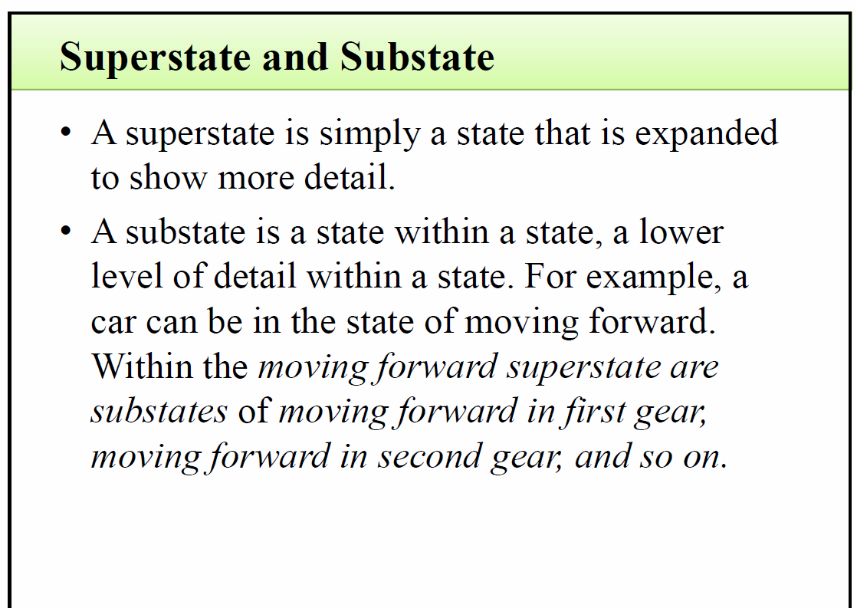

Slide 12
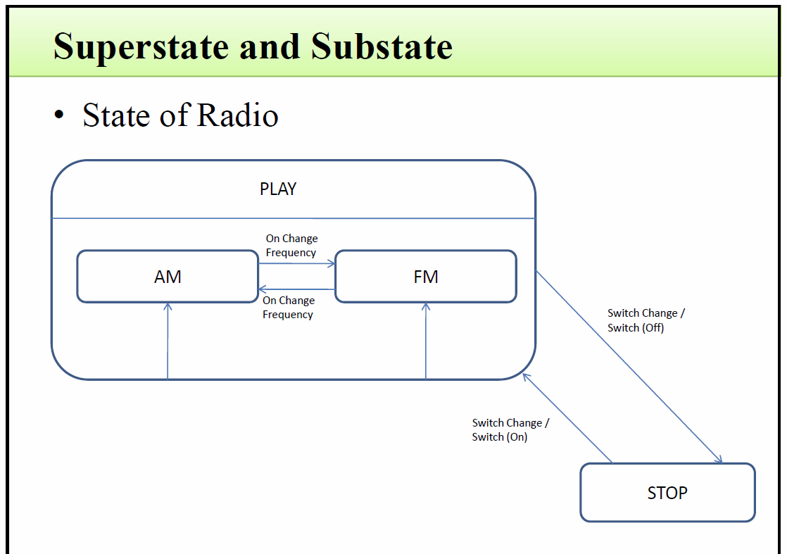

Slide 13
2. Activity Diagram

Slide 14
Activity Diagram
Activity diagrams represent the business and operational workflows of a system.
An Activity diagram is a dynamic diagram that shows the activity and the event that causes the object to be in the particular state.
So, what is the importance of an Activity diagram, as opposed to a State diagram?
A State diagram shows the different states an object is in during the lifecycle of its existence in the system, and the transitions in the states of the objects. WHILE an Activity diagram talks more about these transitions and activities causing the changes in the object states.

Slide 15
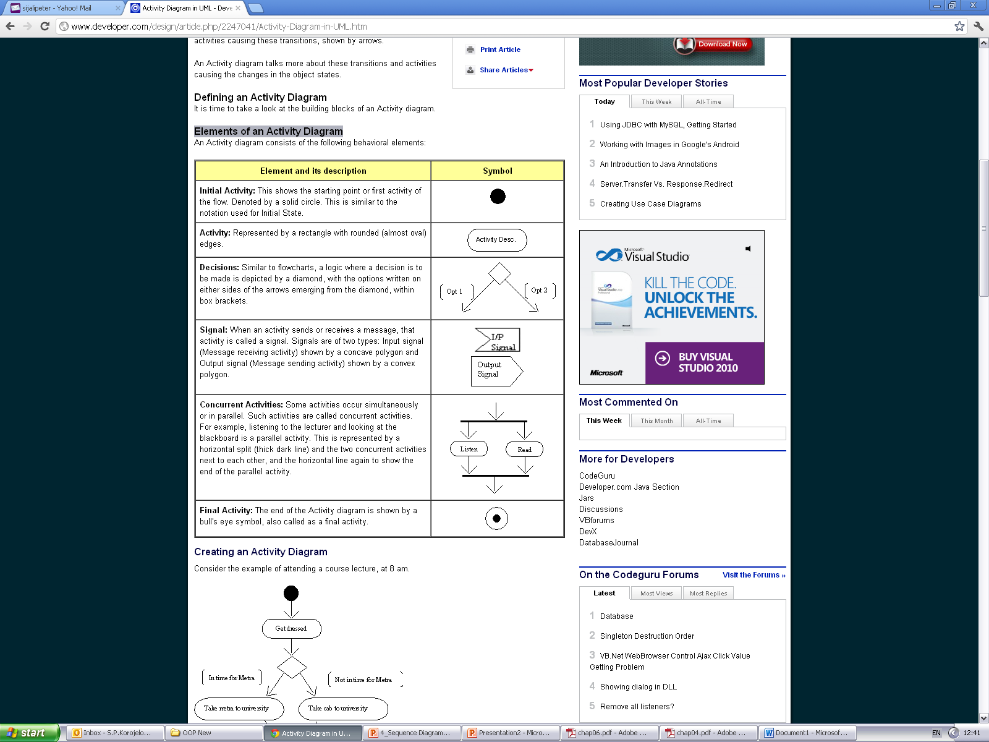
Elements of an Activity Diagram

Slide 16
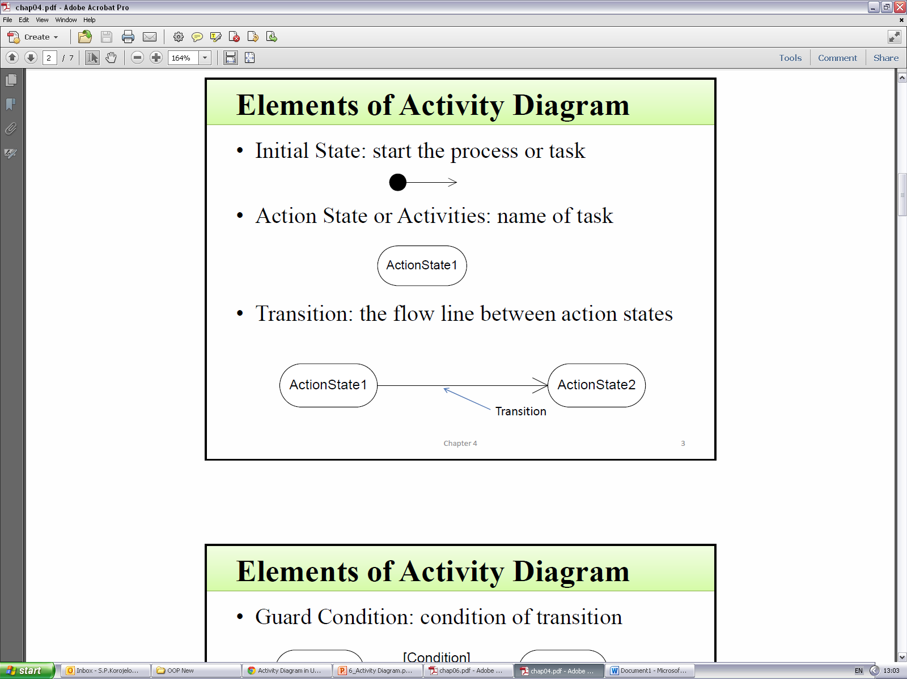
Transition

Slide 17
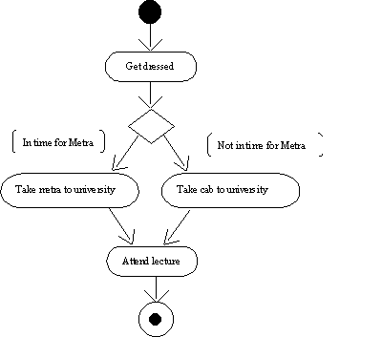
Creating an Activity Diagram
Example 1: Consider the example of attending a course lecture.

Slide 18
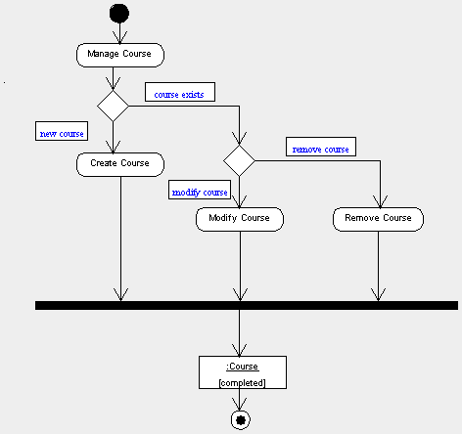
Example 2: activities involved in managing course information carried out by the course administrator in Courseware Management System

Slide 19
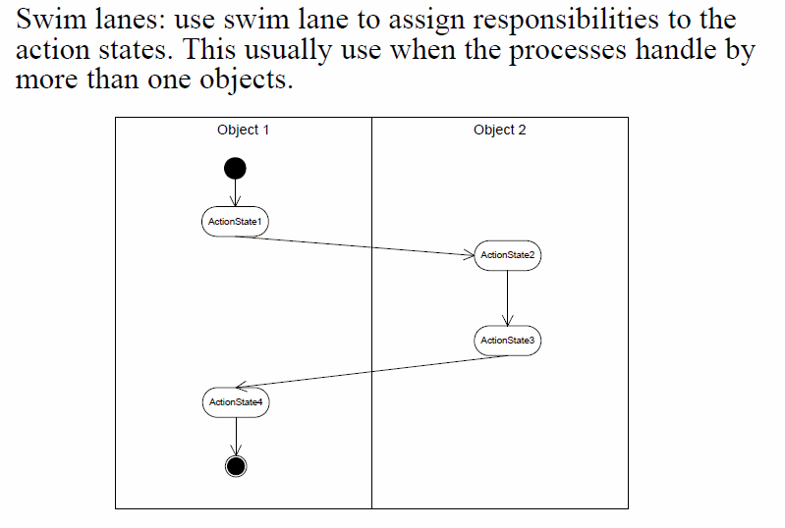
Swim Lanes

Slide 20
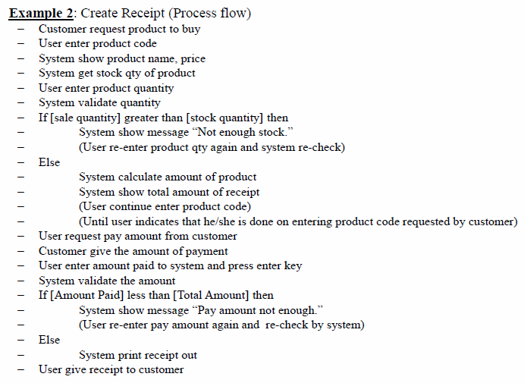
Example 3- create a receipt activity

Slide 21
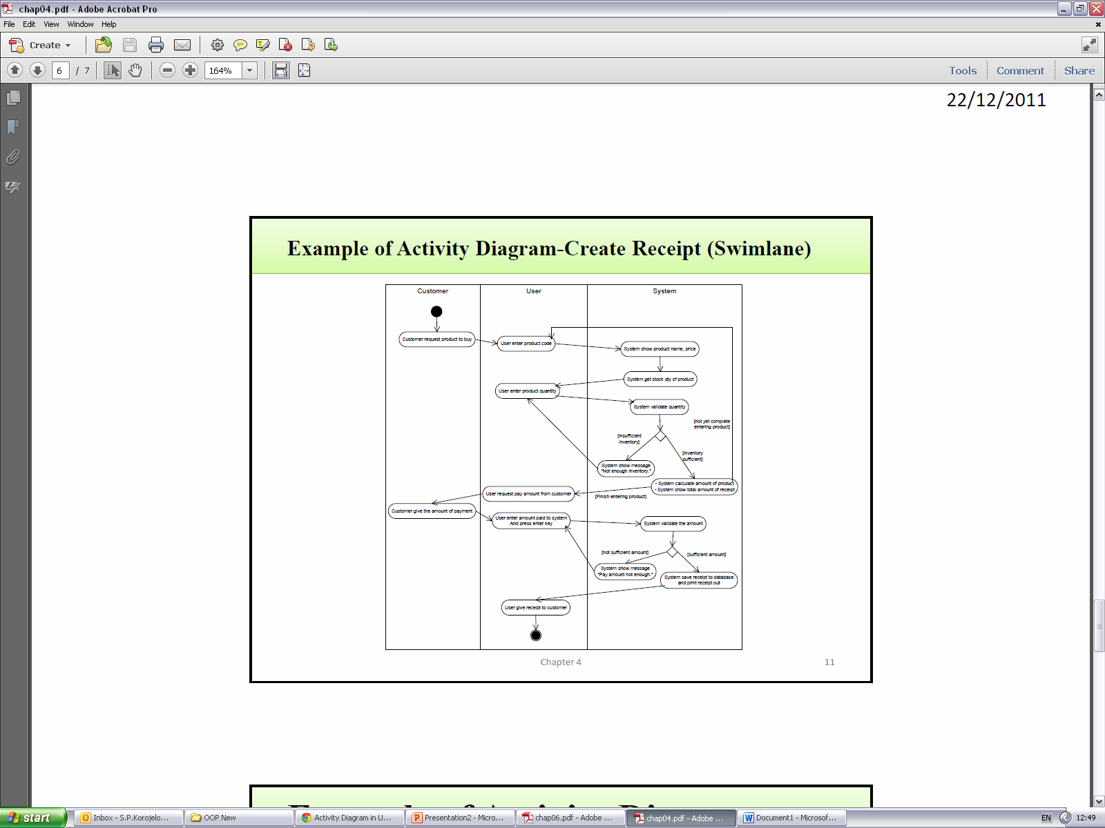
Swim Lanes example- create a receipt

Slide 22
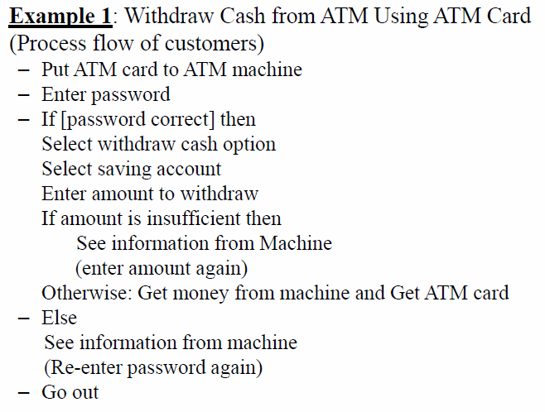
More examples on Activity diagrams
Example 4: Withdraw cash in ATM machine

Slide 23
